Slide 1

Software Engineering
ML22-23-8: Implement the SDR representation in the MAUI application
--o-- Winter Semester 2023/24 _ Damir Dobric -o--
Anh Tong Ngoc Minh - 1317815
Son Pham Tien - 1318513

Slide 2
1. Introduction
Work with .NET MAUI: a cross-platform framework. Implement a MAUI App visualizing Sparse Distributed Representations (SDR).
Scope of the project:
Hardware and software requirements
How to implement the required MAUI app
Evaluate the test results
Possible improvements
Implementation of App SDR steps:
Create a User Interface (UI) in the MAUI getting inputs data and configurations
Modify the logic behind the UI elements
Generate and implement an SDR drawing library to visualize the input data based on requirements.

Slide 3
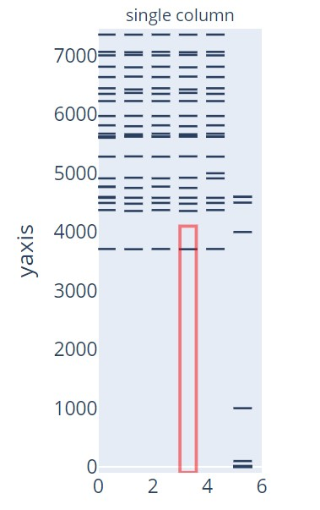
2. Requirements and Getting Started
a. Requirements [1]
Implement the MAUI app used for SDR representation, with follows:
Draw the similar SDR representation like in file draw_figure.py
Use library Maui.Graphics
All arguments taken in via UI (data and parameters).
Implement drawing functionality with the created SdrDrawerLib
Figure 1: Example of SDR representation

Slide 4
2. Requirements and Getting Started
b. Getting Started
The project integrates the latest update ➔ Install at least the following version of IDE, text editor, and MAUI.
Microsoft Visual Studio Community 2022 - v17.8.6 -https://learn.microsoft.com/en-us/visualstudio/releases/2022/release-notes-v17.8
.NET MAUI 8.0 - when installing Visual Studio, choose .NET MAUI to integrate along with the installation.
➔ From v17.8.6, .NET MAUI 8.0 automatically supported.
More information: https://github.com/tongngocminhanh/MAUI_App_SDR/tree/master/MySEProject

Slide 5
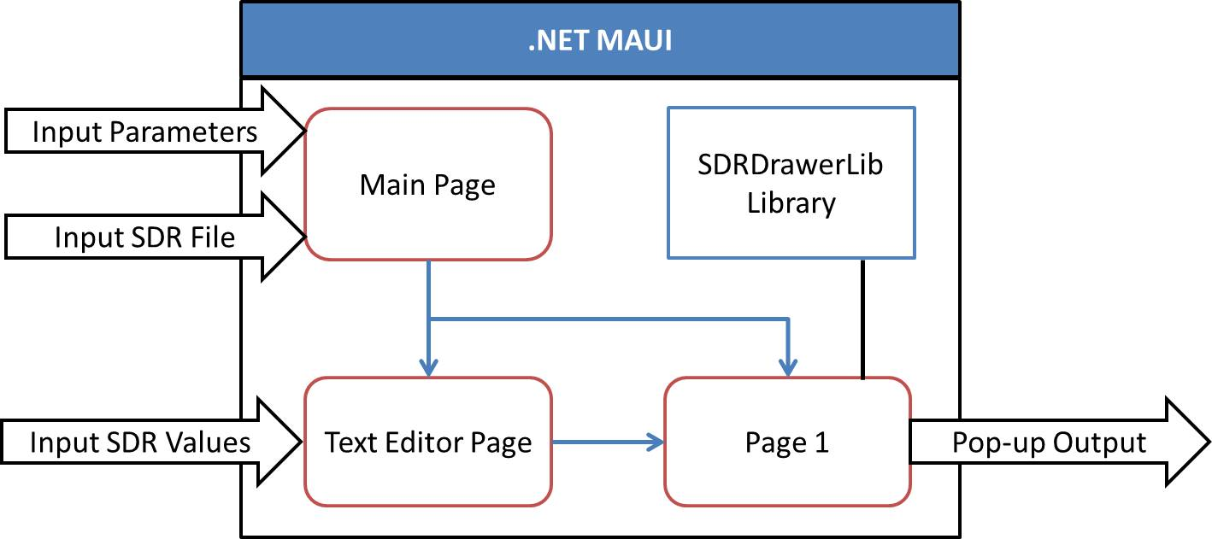
3. Implementation of App SDR
General inputs, outputs, connections among distinguished components if .NET MAUI app
Figure 2: General structure of AppSDR

Slide 6
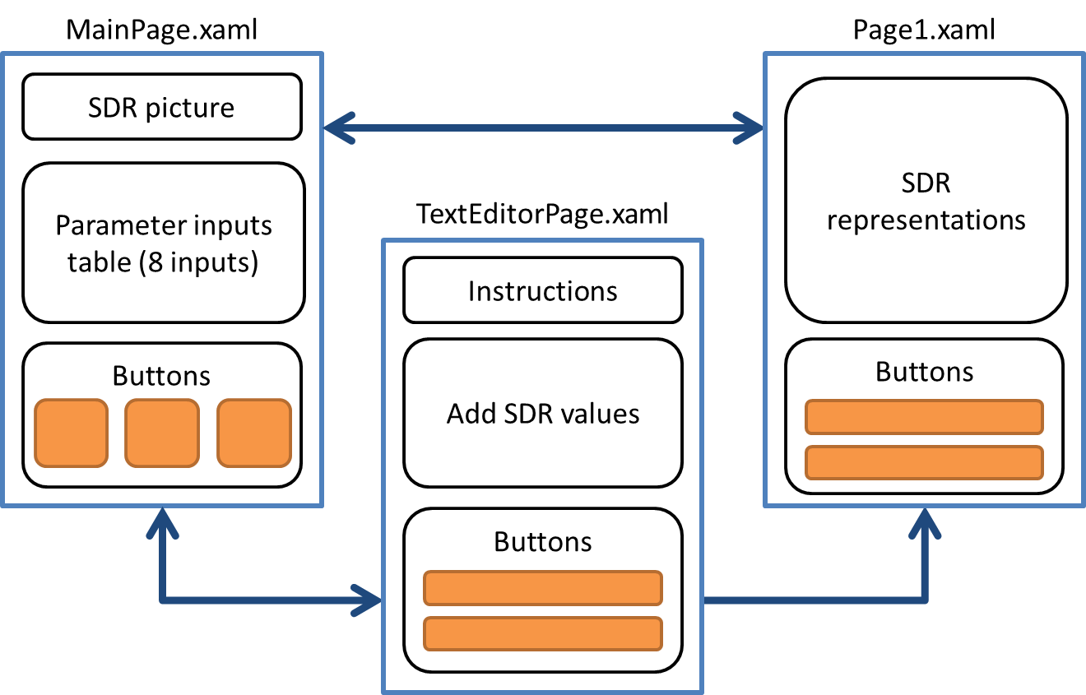
3. Implementation of App SDR
a. UI implementation
Participating pages
Main Page (Primary)
Text Editor Page
Page 1
Important content
Layout
Components position
Navigation between pages
Figure 3 : General display and connections of UI pages

Slide 7
3. Implementation of App SDR
b. SDR drawing library implementation
The primary idea of all drawing functions is based on three ICanvas methods:
DrawString(string value, float x, float y, HorizontalAlignment horizontalAlignment, VerticalAlignment verticalAlignment)
DrawRectangle(float x, float y, float width, float height)
DrawRoundedRectangle(float x, float y, float width, float height, float cornerRadius)

Slide 8
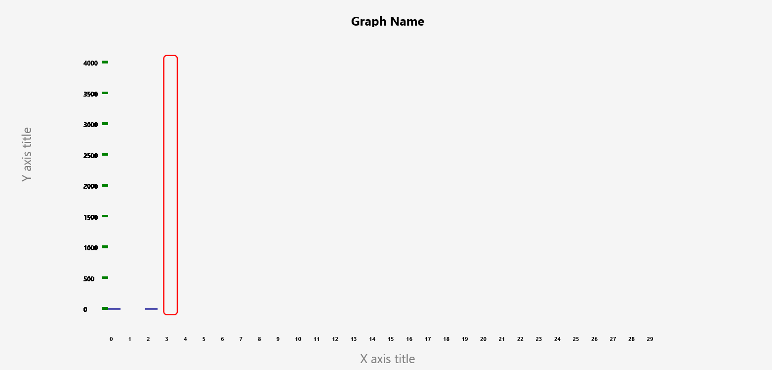
3. Implementation of App SDR
b. SDR drawing library implementation
Figure 3 : General visualisation components of SdrDrawerLib library

Slide 9
3. Implementation of App SDR
c. Logic implementation
1. UI Files and Direct Logic: Each UI file has its own code-behind (*.xaml.cs) for simple logic.
2. MVVM Pattern:
For complex logic, use MVVM [2].
Separate ViewModels (MainViewModel.cs, Page1ViewModel.cs) handle data and logic.
3. MVVM Benefits:
Cleaner code organization.
Easier maintenance and testing.
4. Implementation Guidelines:
Simple logic in UI code-behind.
MVVM for complex logic.

Slide 10
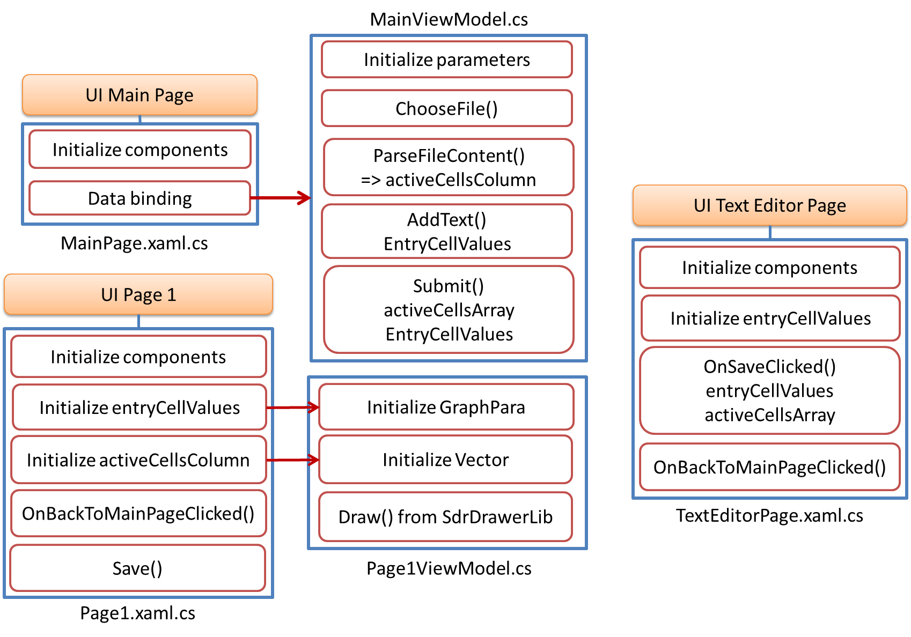
Figure 3 : General structure and components logic implementation

Slide 11
4. Testing and evaluation
a. Testing
Testing and evaluation on three cases.
Case 1 and case 3 are illustrated in next slides.
Case 2 is too big to present => no test case 2 provided
Table 1: Comparison characteristic within 3 cases
 | Case 1 | Case 2 | Case 3
Input parameters | Table entry | Table entry | Table entry
Input SDR values | File | File | Keyboard
SDR columns | <30 | >1000 | 8
Screen fit | Fit | Scroll view | Fit
Saved figure | Good quality | Bad quality | Good quality

Slide 12
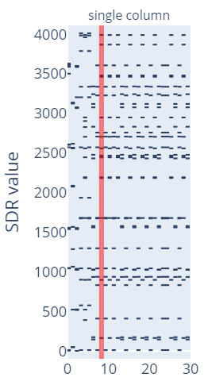
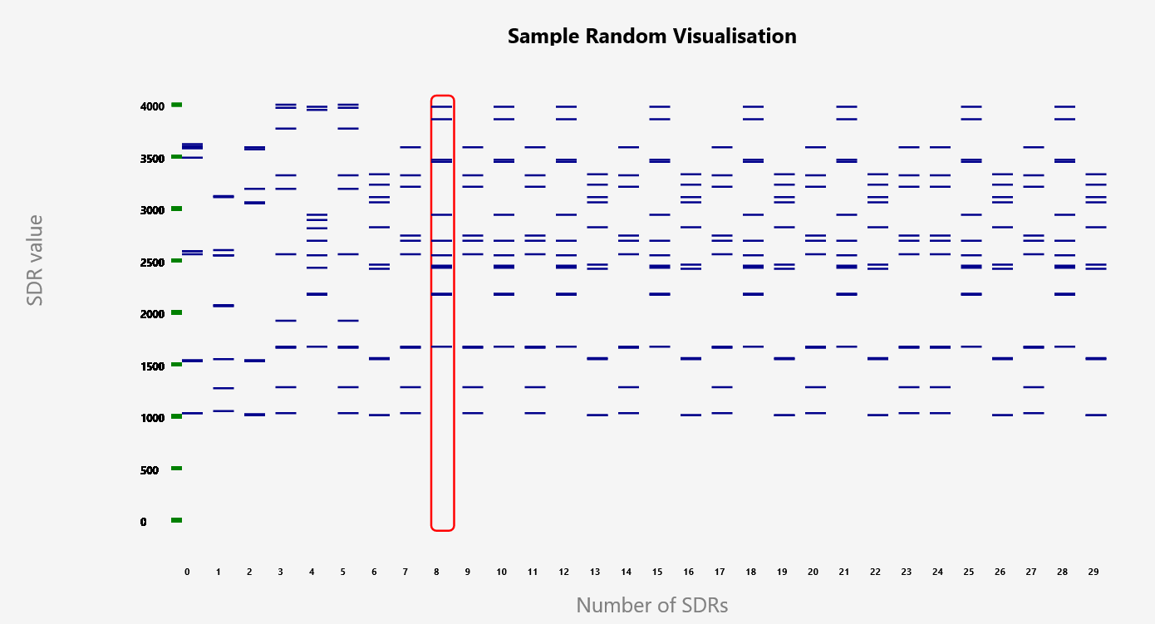
4. Testing and evaluation
a. Testing
Figure: Results of Python and App in case 1

Slide 13
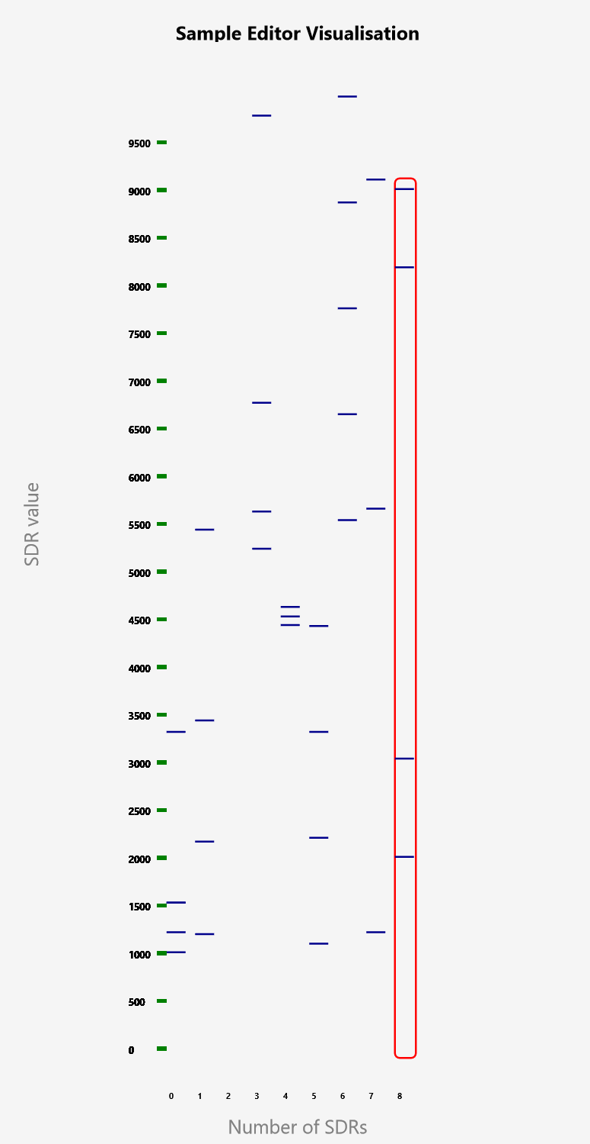
4. Testing and evaluation
a. Testing
Enter text block for SDR values:
1021,1234,1542,1540,3333,1000 1214,5454,3454,2180,218 123, 124, 145, 156, 189, 656 5646, 9796, 478, 6786, 5250 464, 4646,4546,4455,778 1111,2222,3333,4444 5555,6666,7777,8888,9999 1234,5678,9123 10,8202,9025,2024,3058
Parameter is the same with case 1, except Graph Name and picture name.
Figure: Results of App in case 3

Slide 14
4. Testing and evaluation
b. Evalution
AppSDR Excels Over Python model in clarity, efficiency, and functionality
Customizable Parameter Handling add flexibility for user in graph customization and SDR value visualization within specified ranges.
Efficient Data Handling: Manages large datasets seamlessly
Accurate User Input Representation: Precisely visualisation.
Areas for Improvement Identified
Enhanced User Experience: With efficient parameter handling, robust visualization capabilities, and accurate data representation.

Slide 15
5. Conclusion
Full fill project’s requirements: AppSDR taking inputs and producing SDR representations visualisation.
Compare with the existing model.
Adapt the new one: text editor directly from keyboards.
Place for improvements.
Generate relevant documentation for the project.

Slide 16
Referenced sources
[1] D.Dobric, “Project ideas 2018-2023”, Frankfurt am Main, Germany. Frankfurt University of applied Sciences, October 2023. Accessed on: https://github.com/UniversityOfAppliedSciencesFrankfurt/se-cloud-2023-2024/blob/main/Project%20Ideas%202018-2023.docx.
[2] Microsoft Documentation, “The Model-View-ViewModel Pattern”, Xamarin.Forms, 2021. Accessed on: https://learn.microsoft.com/en-us/xamarin/xamarin-forms/enterprise-application-patterns/mvvm .

Slide 17
Demo part

